Slide 1
Parse scRNAseq Summary
Yong Lin

Slide 2
Samples Summary
total sort count
ht9: 245136
ht11: 728053
ht12: 76760
ht14: 1036766

Slide 3
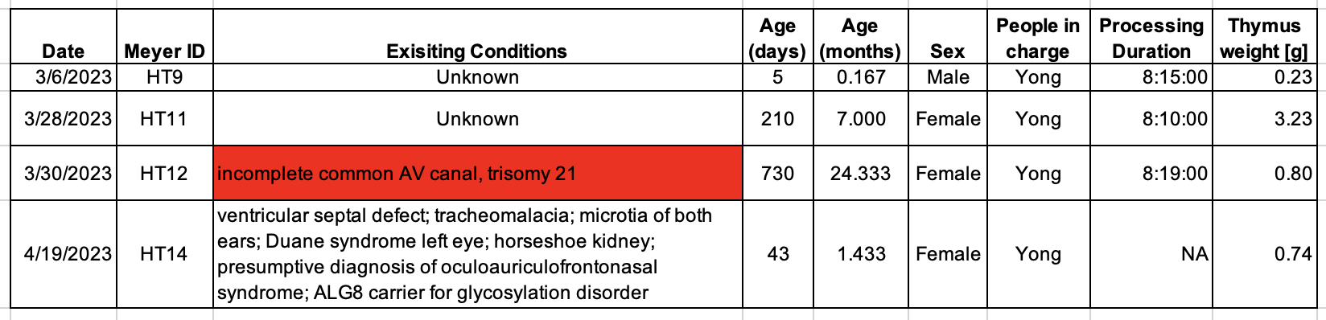
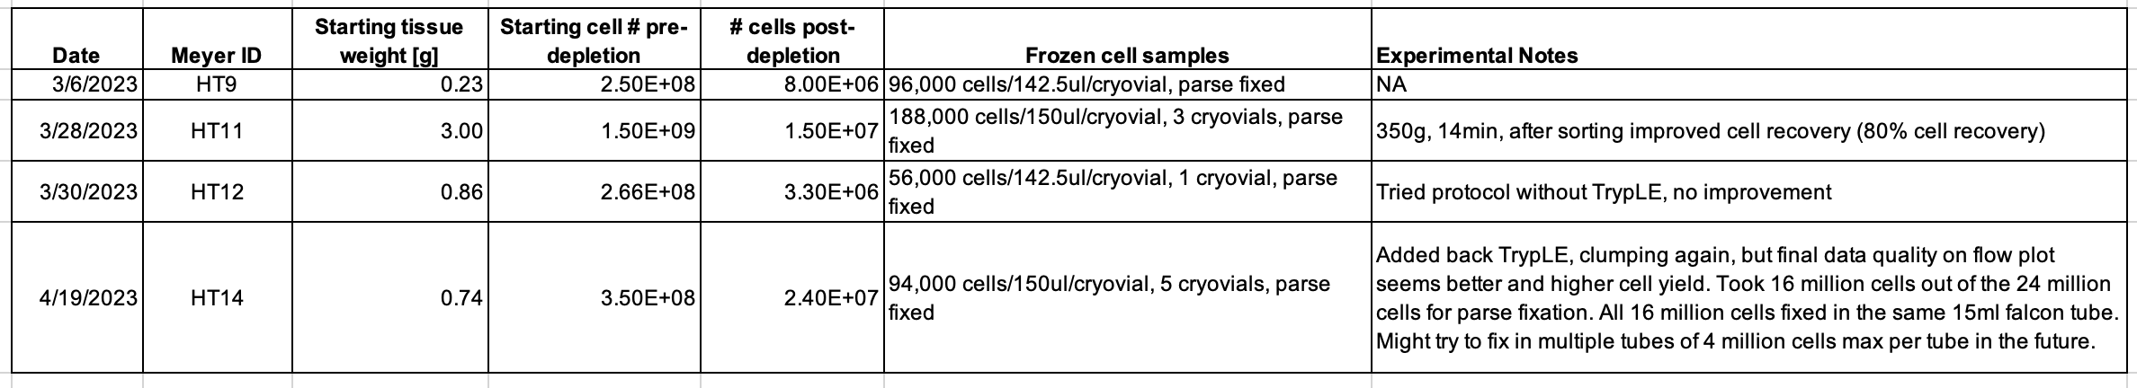
Samples Summary

Slide 4
QC plots
Linear scale
Log scale

Slide 5
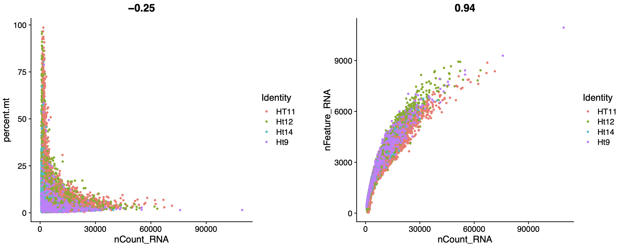
QC plots

Slide 6
QC plots
nFeature
nCount
Percent.mt

Slide 7
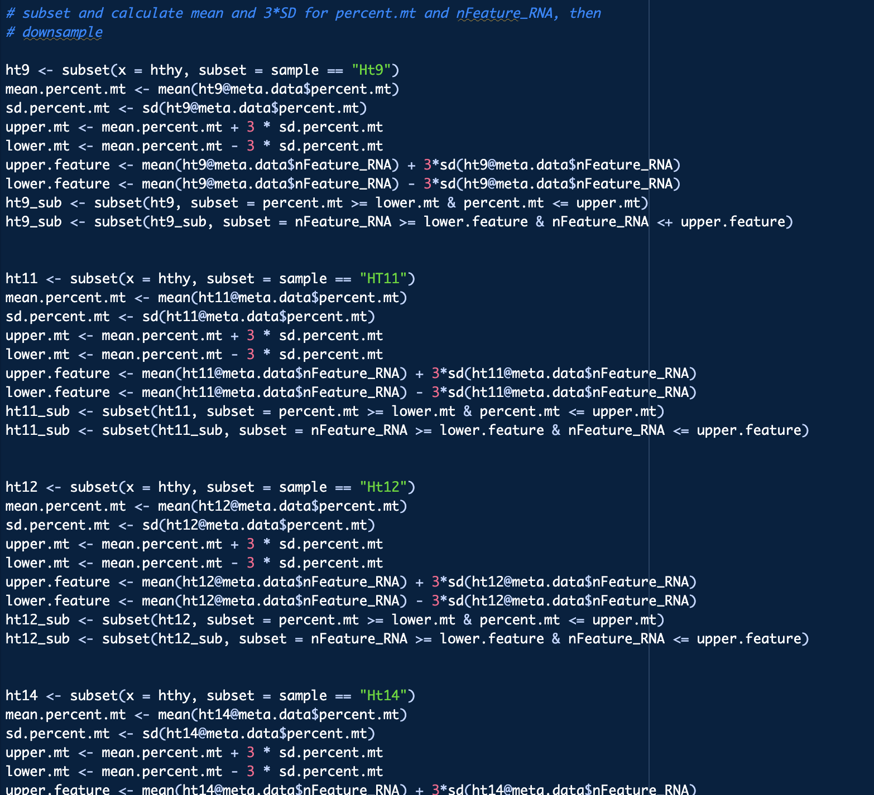
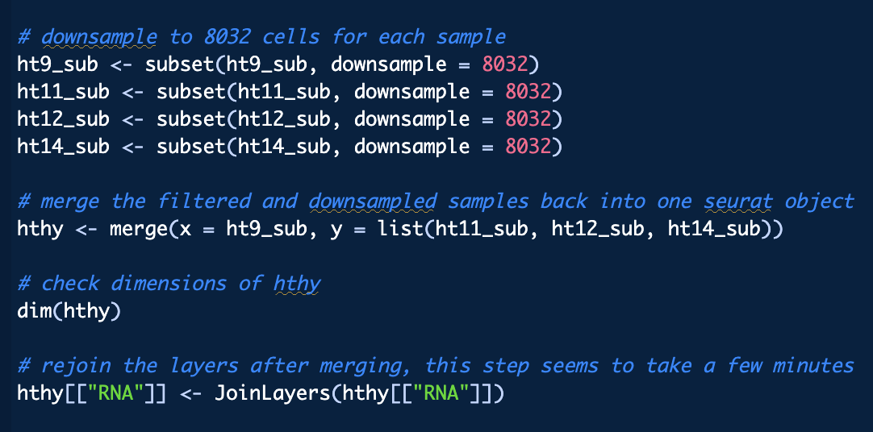
Subset > QC filter > downsample > merge

Slide 8
QC plots: post filter
Linear scale
Log scale

Slide 9
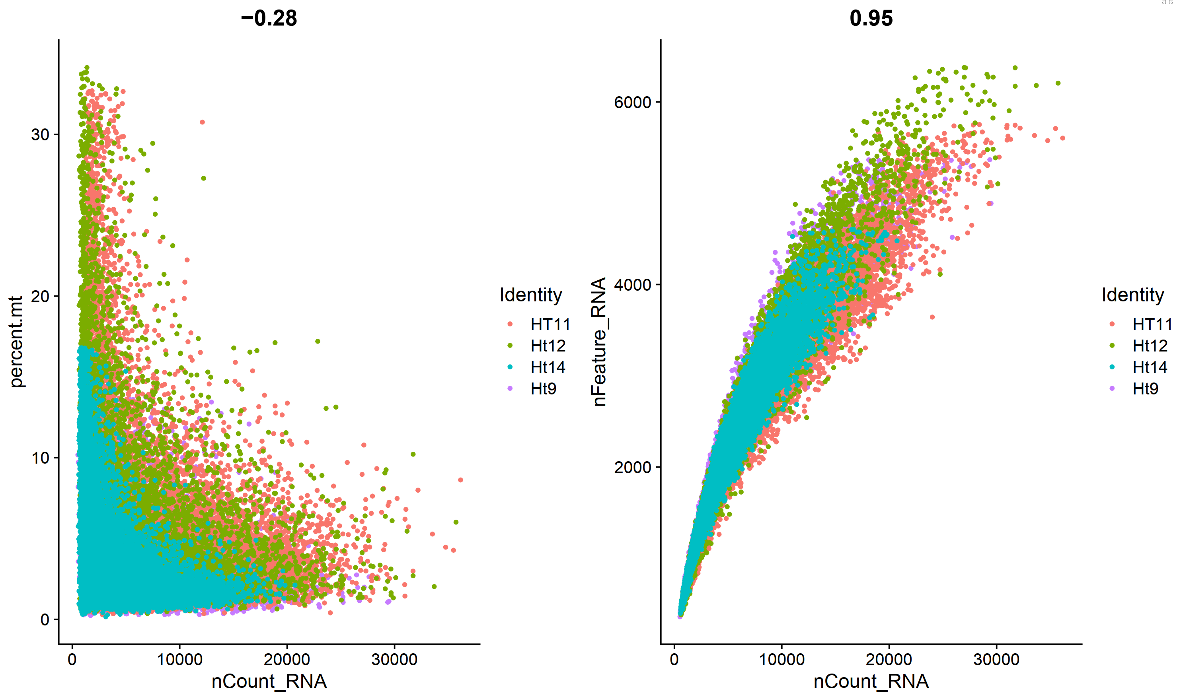
QC plots: post filter

Slide 10
QC plots: post filter
nFeature
nCount
Percent.mt

Slide 11
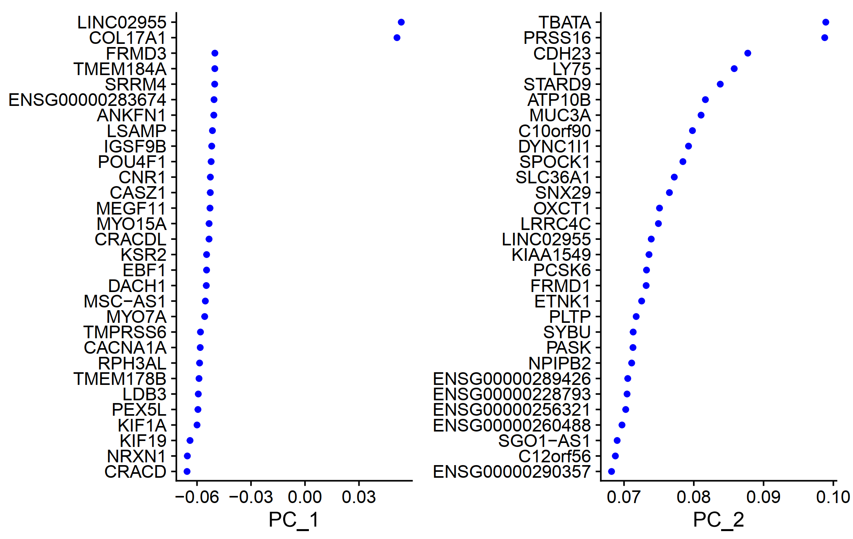

Slide 12
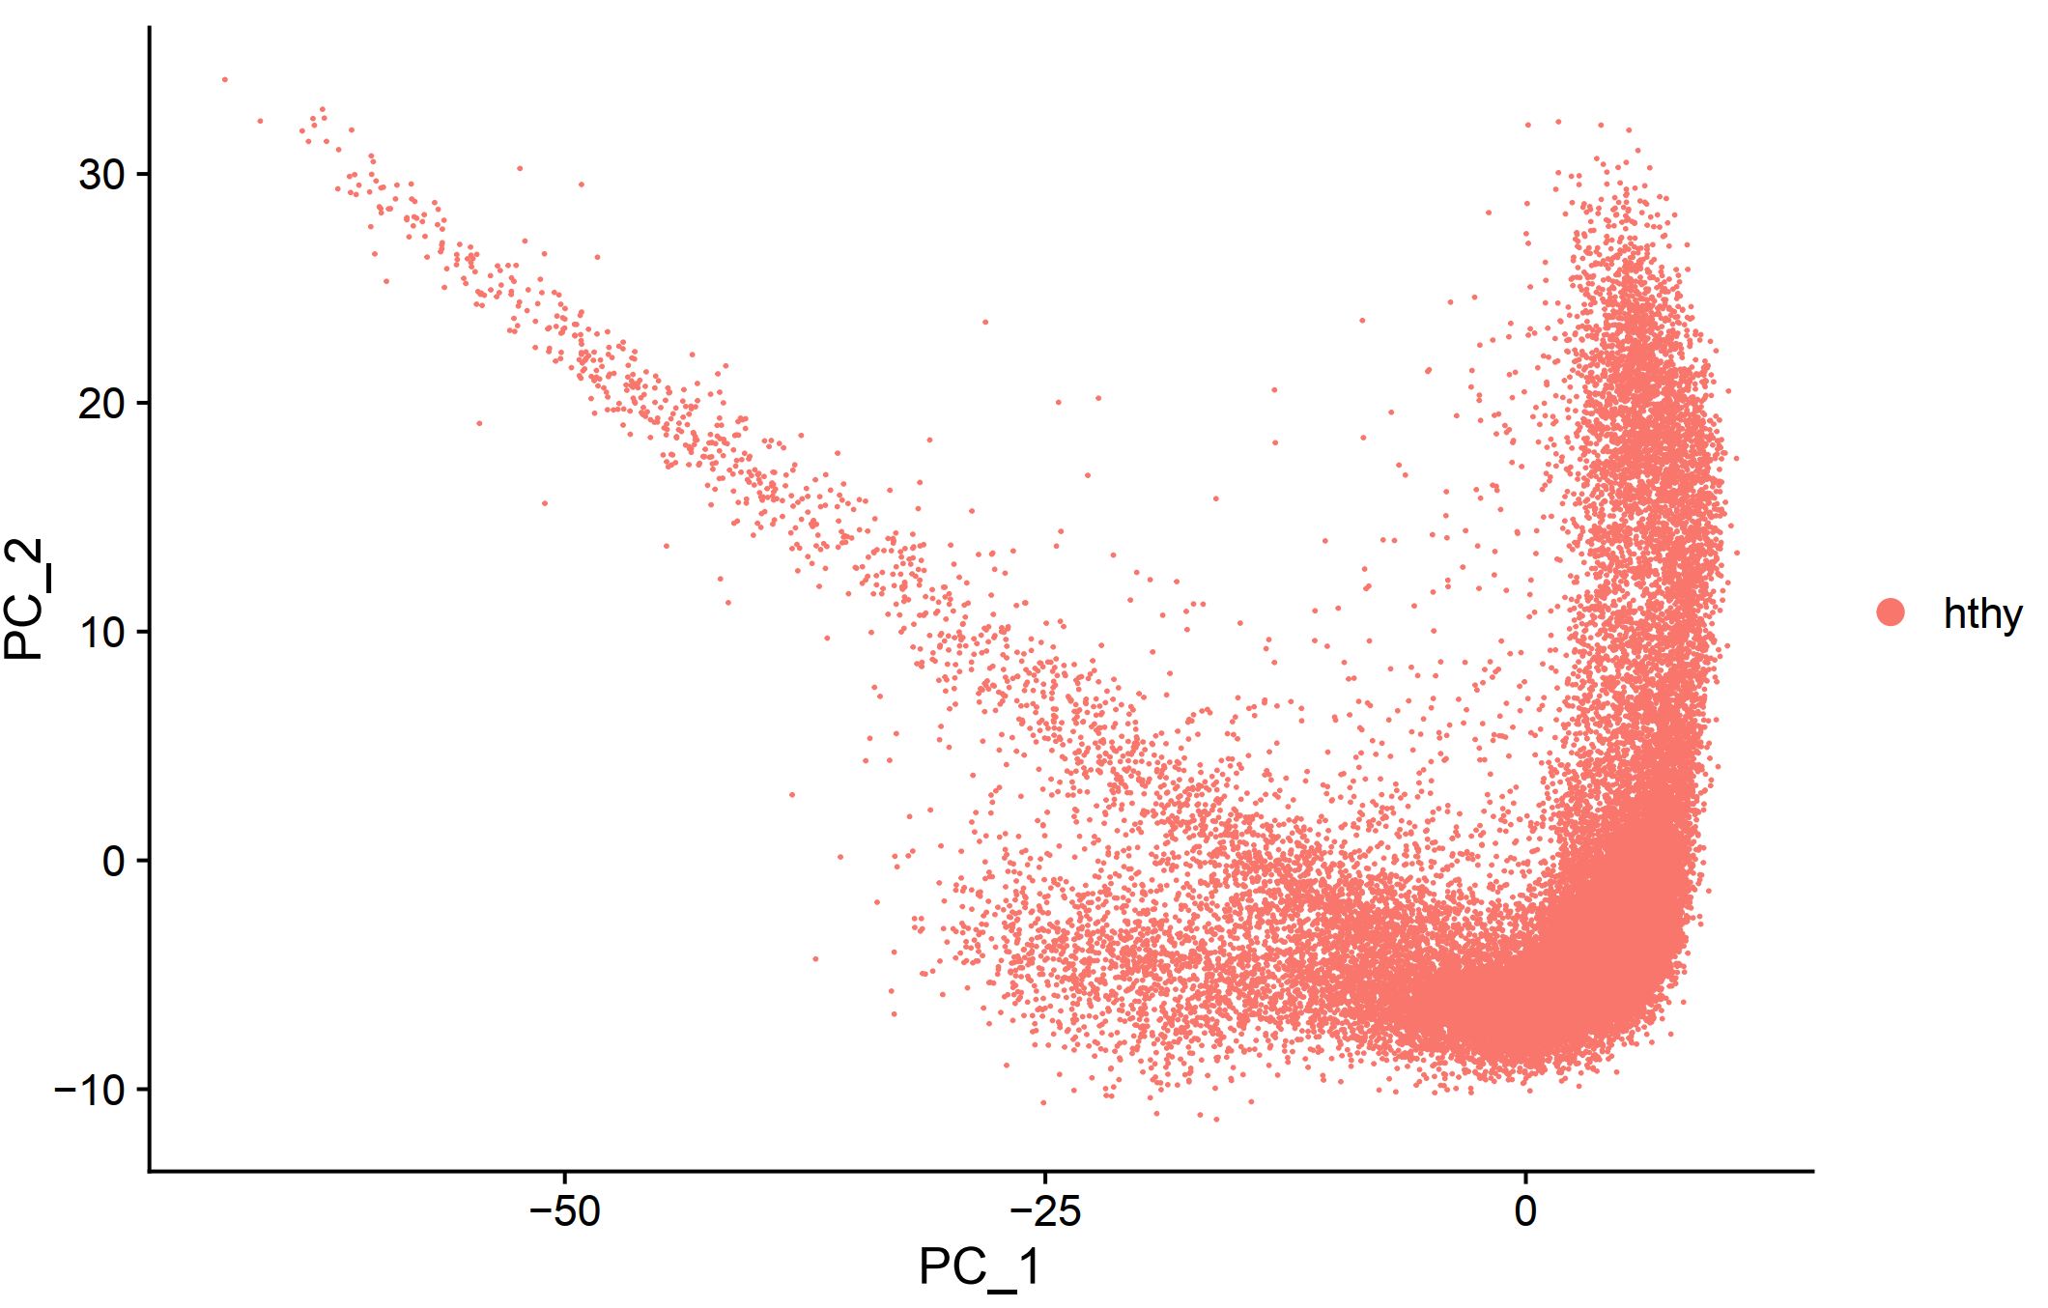

Slide 13
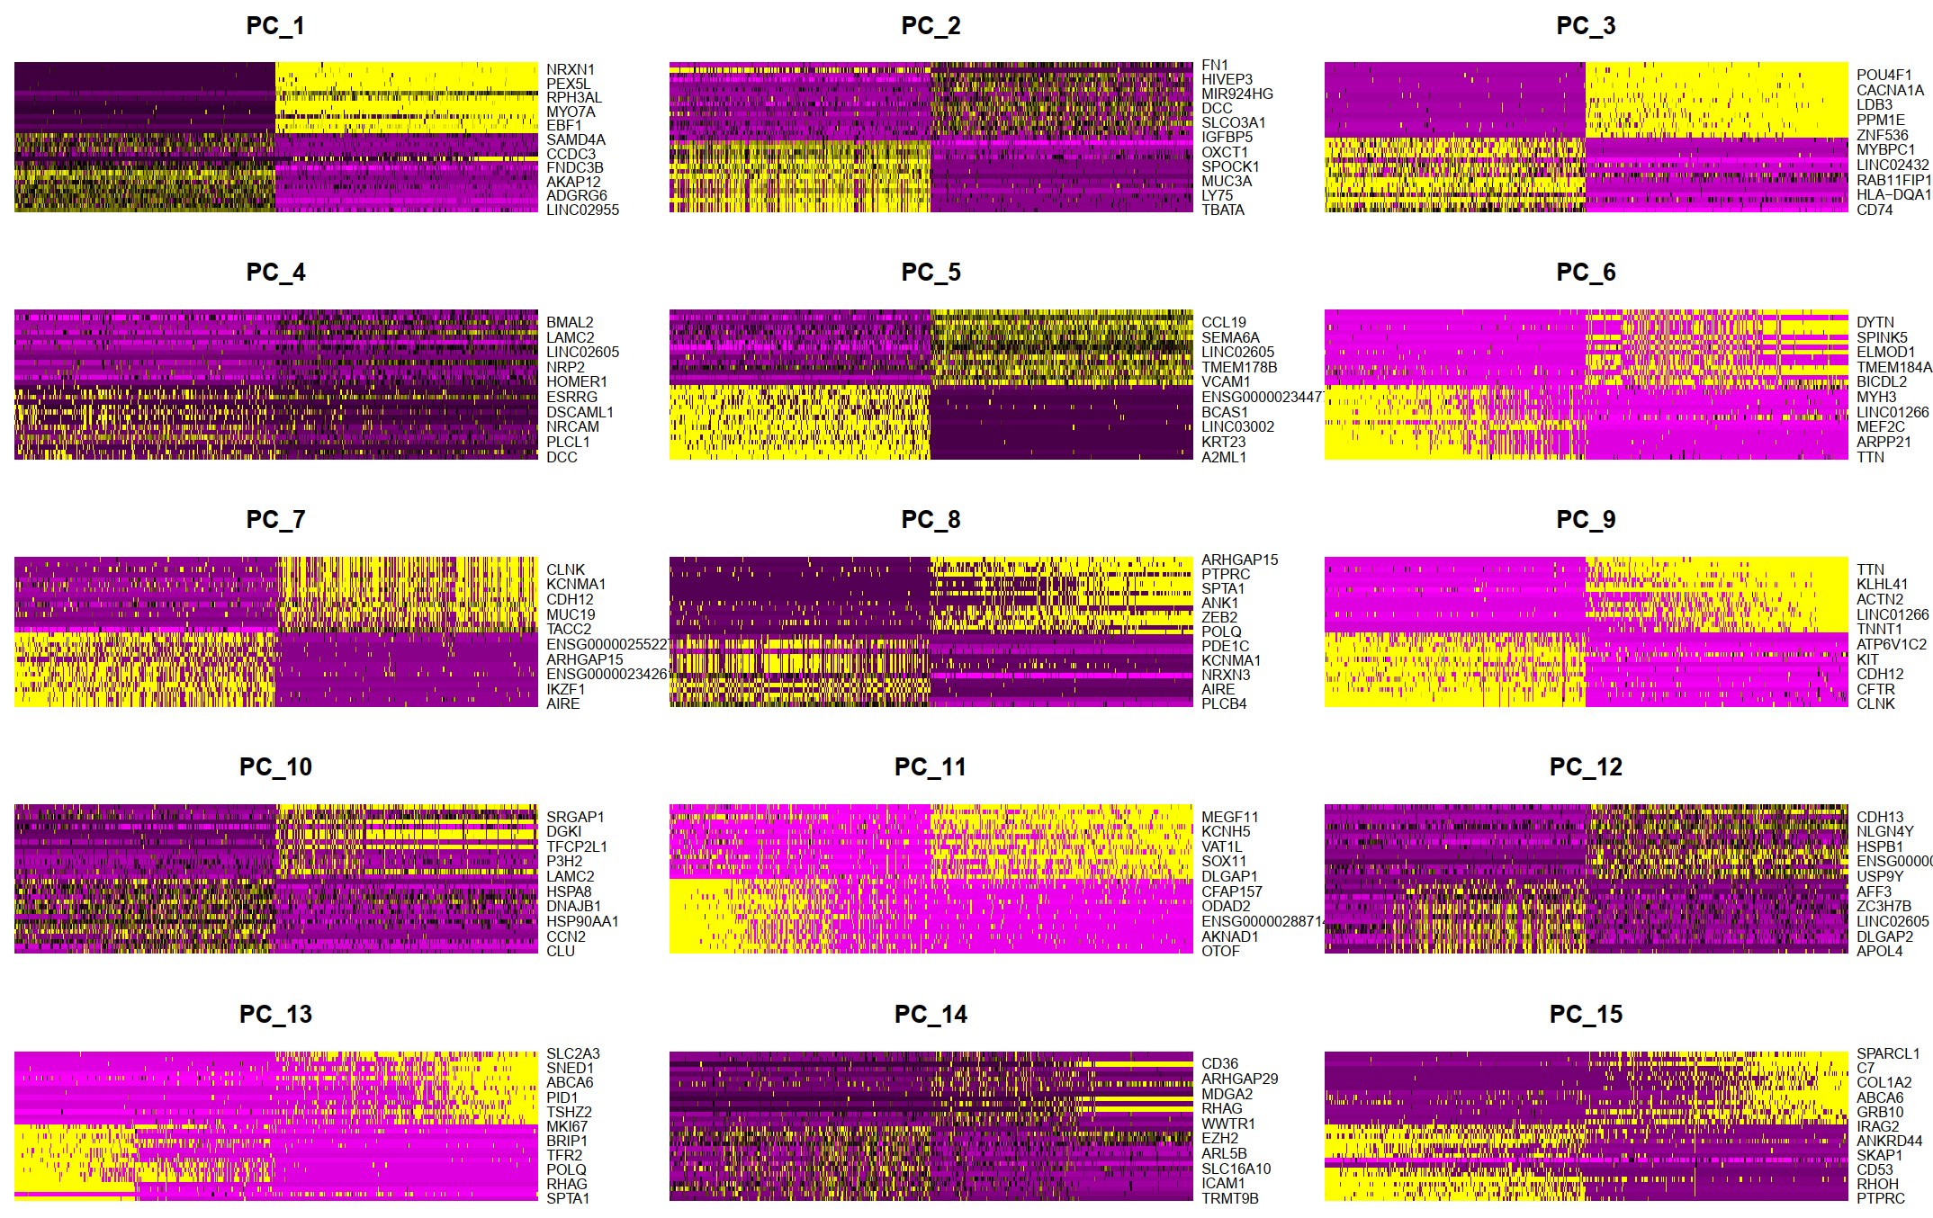

Slide 14
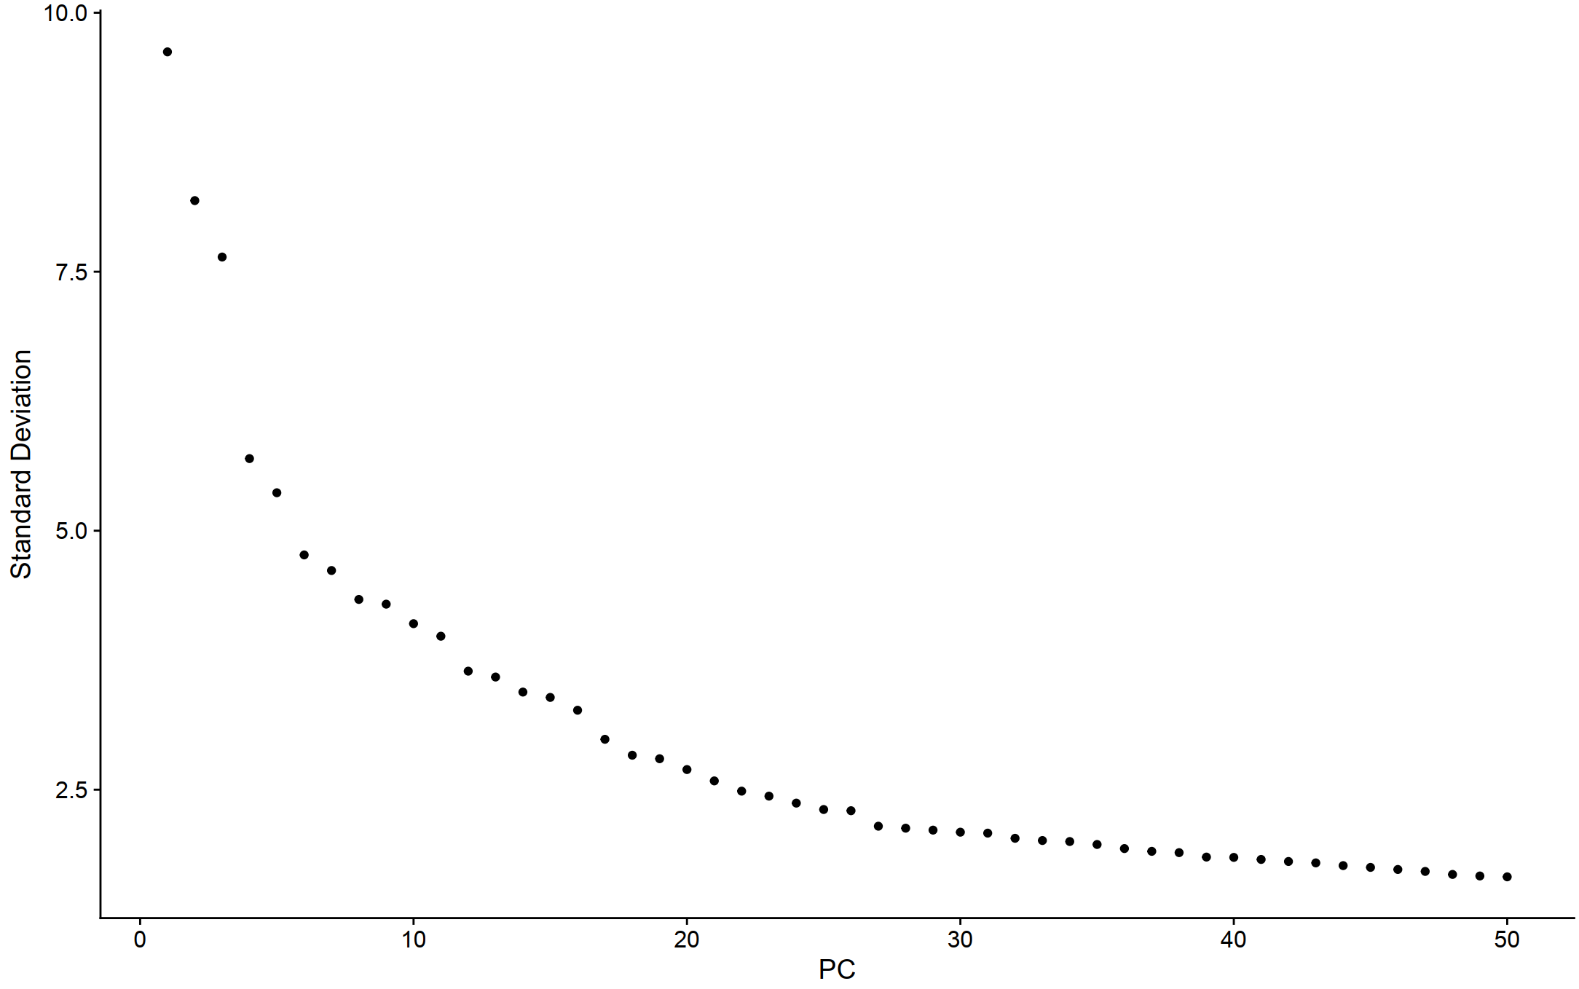

Slide 15
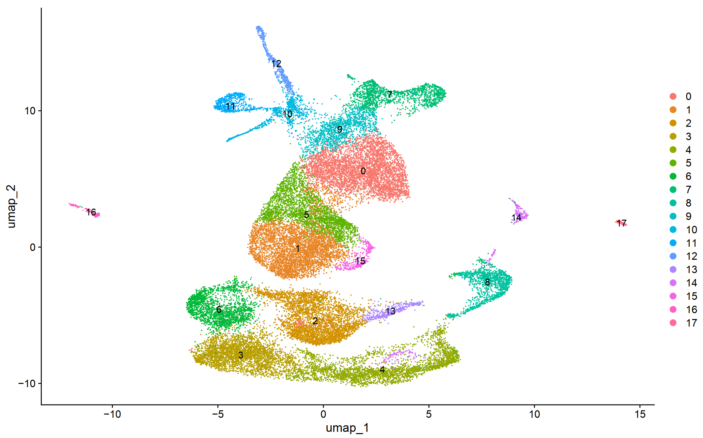

Slide 16
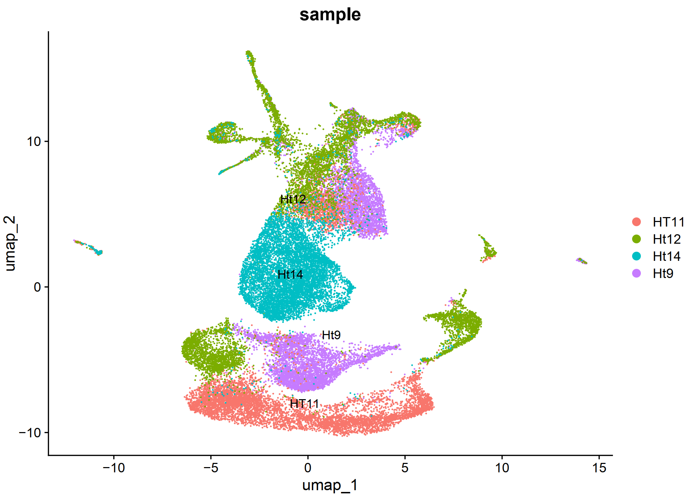

Slide 17
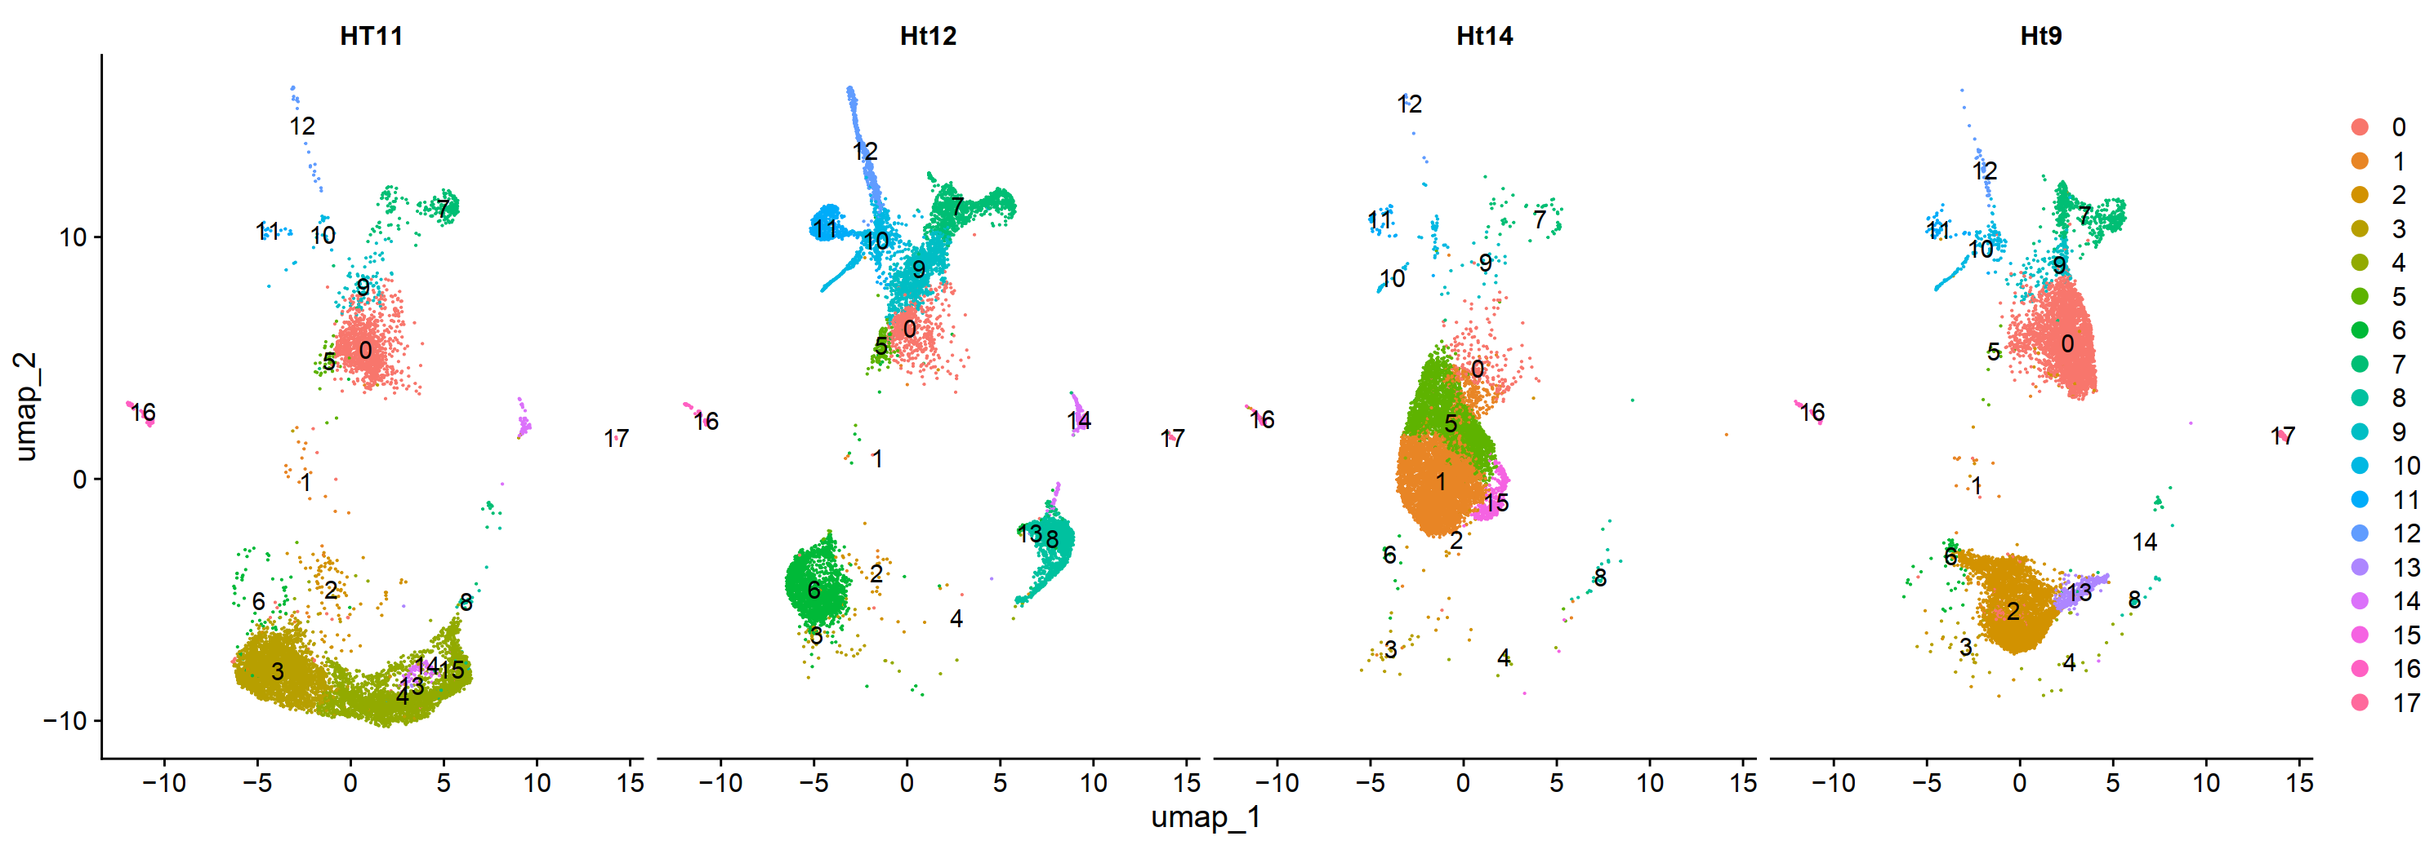

Slide 21
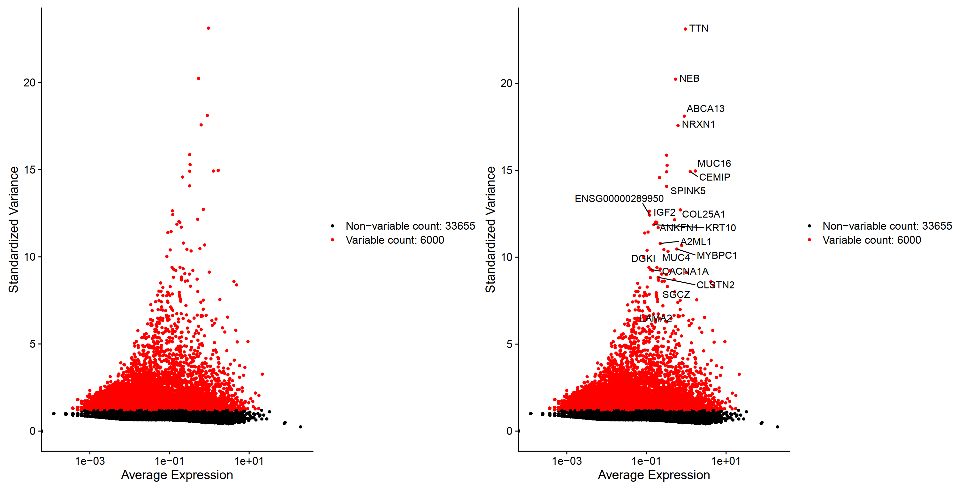

Slide 22
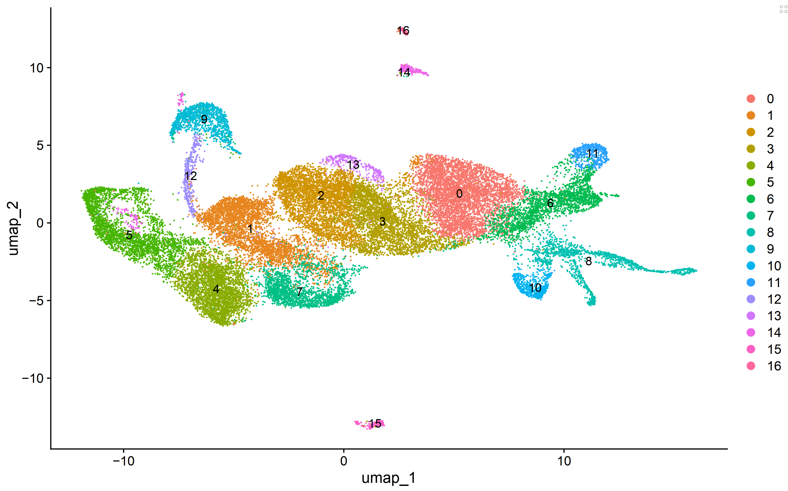
Clusters

Slide 23
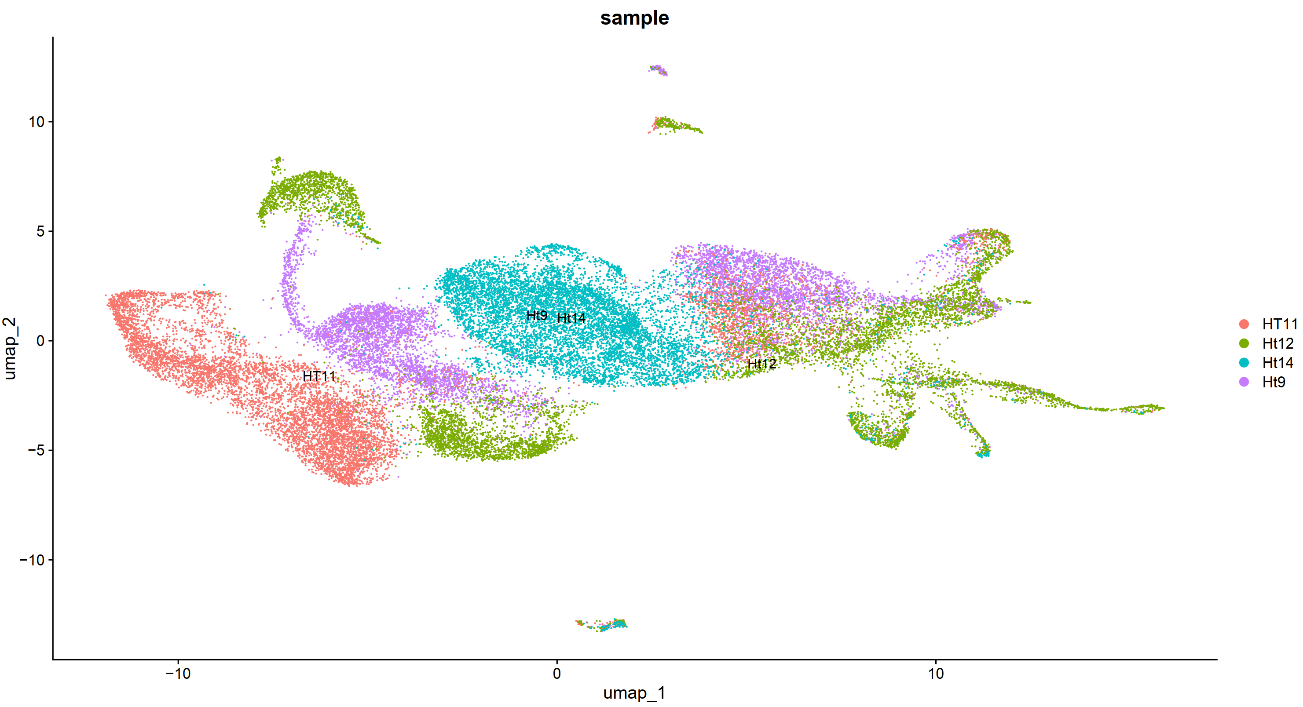
Clusters: by sample

Slide 24
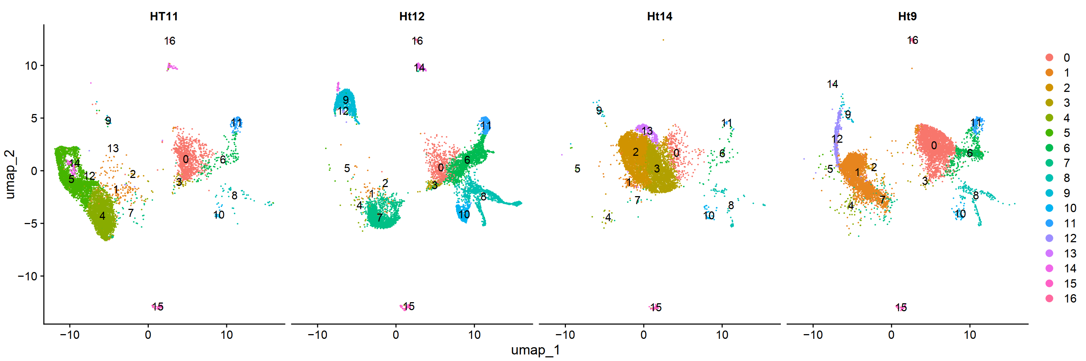
Clusters: split by sample

Slide 25
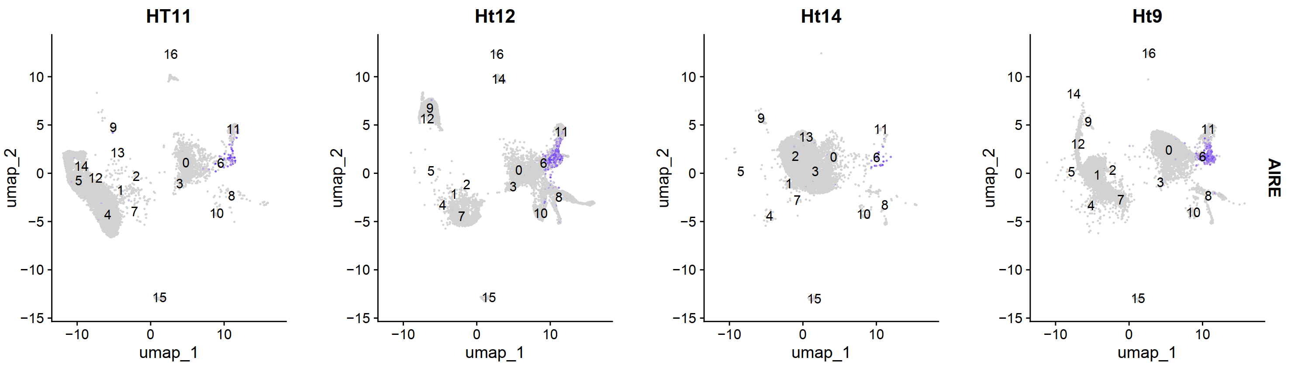
AIRE

Slide 26
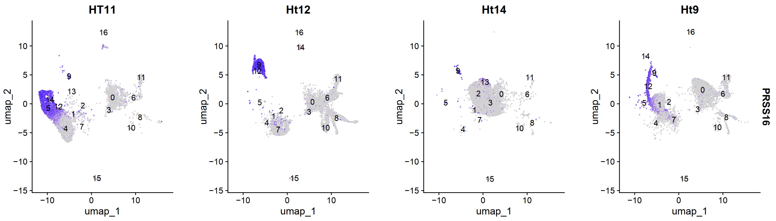
PRSS16

Slide 27
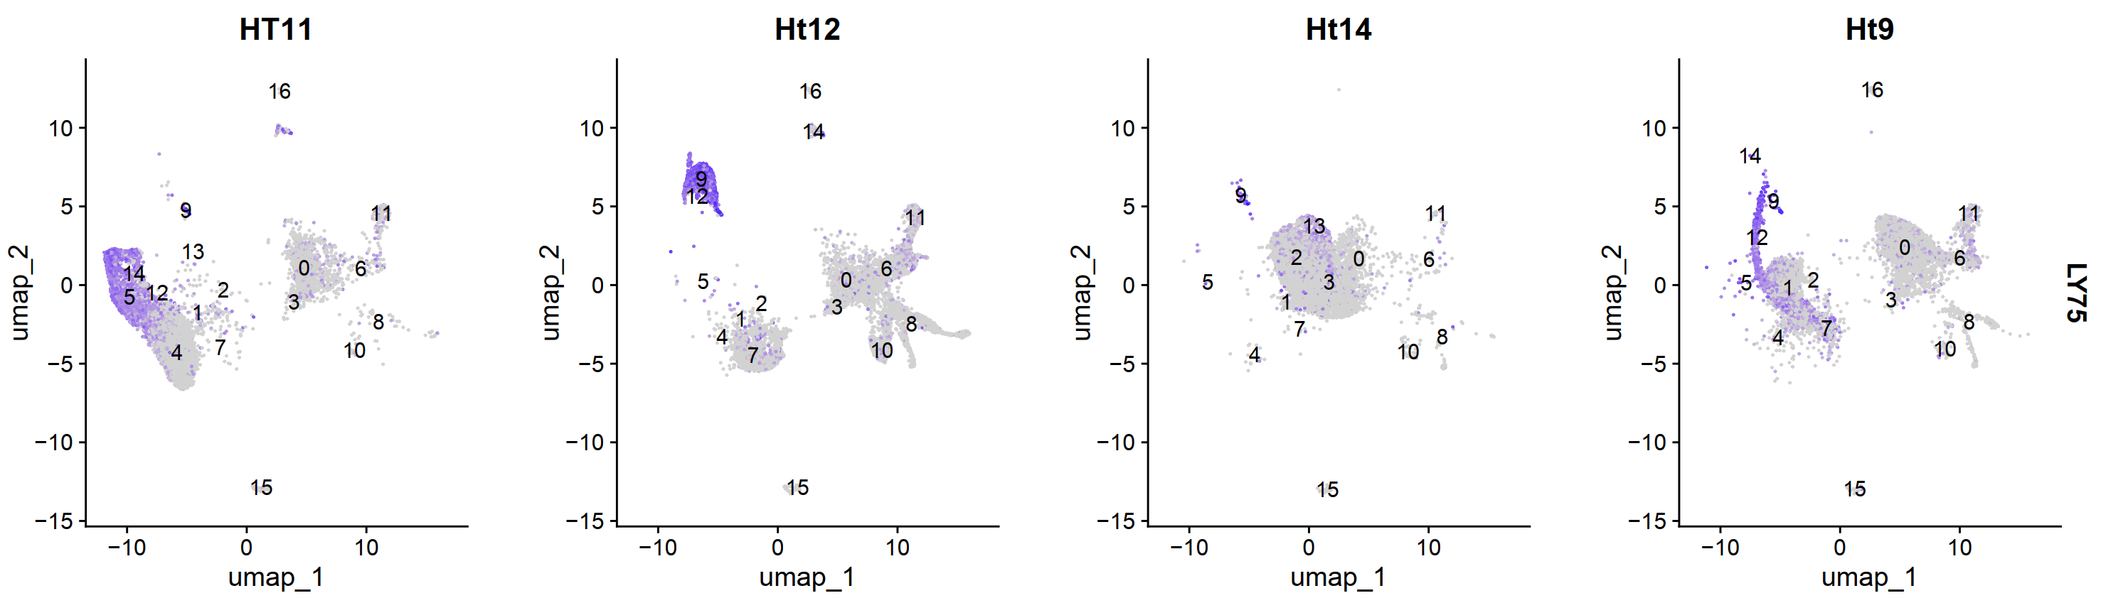
LY75

Slide 28
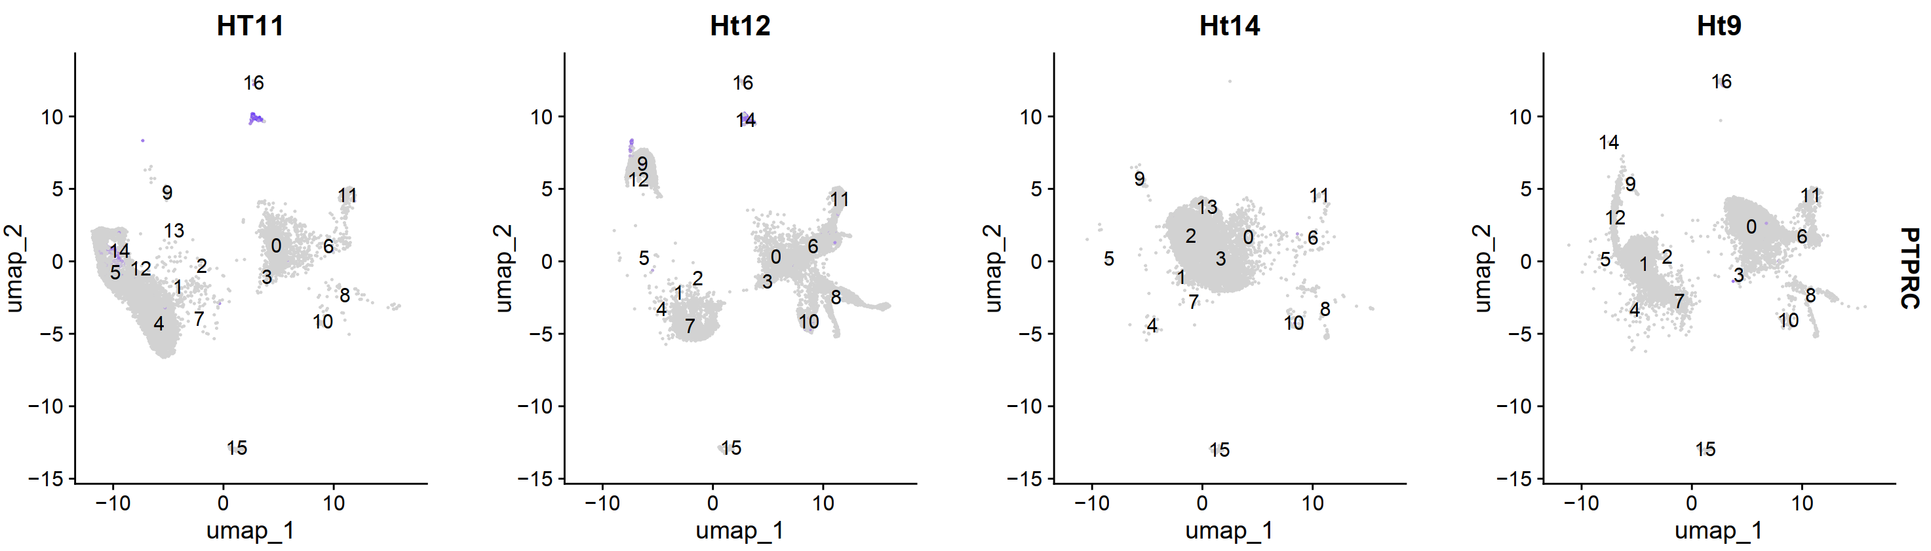
PTPRC

Slide 29
asdf
asdf

